Slide 1



Smart Consuming Automation
Jarrod hattING – THIBAUD DE TREGLODE - Ryckiel hossie

Slide 2
The problem

Slide 3
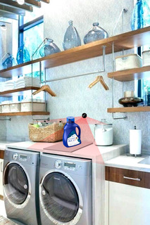
The product
How does it work?
Hardware equiped
Back-up by an app for additional info
Can be positioned anywhere

Slide 4
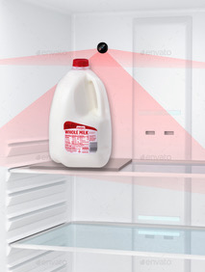
The product
What are the benefits?
Next steps
Automate ordering process
Increase productivity
Avoid waste & back-up purchase
Develop prototype
Market research
Additional features

Slide 5
Revenue Stream options
Option 1
Option 2
Option 3
Price
Between $200-$300
$100
$50
Subscription
No monthly fees
Monthly subscription with add-ons on an app
Monthly subscription with add-ons on an app
Commission
No commission
1%-2% fee on every purchase
No Commission
Data Management
Data are kept private
Data are kept private
Data are sold

Slide 6
Key Facts
The average person goes to the grocery store 1.6 times a week and spends 43 minutes there (without travel time).
Nearly 25% of grocery shopping dollars are spent on processed foods and sweets.
One pound of food is wasted every day by an average American.
Figures about missing items
Notes:
Sources: https://www.fivestarhomefoods.com/blog/grocery-shopping-facts#:~:targetText=1.,hours%20grocery%20shopping%20per%20year.

Slide 7
Market Study
Conduct a market study among young workers to determine:
Determine the exact painpoint (save time or sustainable)
How painful the painpoint is ?
How much would they be willing to pay to solve it?
What additional feature would be of interest to them?

Slide 8
Main Value proposition
For young workers who wants a more efficient grocery routine, SMA is a domestic appliance that helps users save time and consume in more sustainable way unlilke Amazon Dash our product is autonomous.

Slide 9
The competition
Product | Description | Problem
Amazon Dash | Amazon Dash is a consumer goods ordering service which uses proprietary devices and APIs for ordering goods over the Internet. | Requires human intervention Do not tackle the waste issue Can only be used on Amazon

Slide 10
Product map

Slide 11
Timeline

Slide 12
Go to market strategy
Develop an independ player focusing on conecting the customer to the marketplace. A company will be built and will sell SMA directly to users who will then use the product on their preferred marketplaces.
Develop partenships with retail grocery stores (Amazon, Walmart…) who will market the product to their directly with a close back end
Develop the product with a company within the smart home industry to propose a full range of service to the end user.

Slide 13





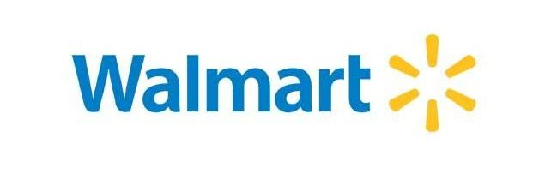
Source of funding
Corporate Developers
Venture Capital funds
TO BE DETERMINED

Slide 14
Exit options
Develop the start-up IPO: This would require a large amount of investment to scale the project and take care of Manufacturing, Sales & Marketing, Distribution, Aftersales services.
Buy-out: Sell the project to a player within the domestic appliances/ smart home business (i.e Samsung…)
Joint-venture: Develop the product alongside with a company within the domestic appliances/ smart home business (i.e Samsung…)

Slide 15
Thank you!

